Slide 1

Public Health Data Standards Consortium http://www.phdsc.org
Notes:
The purpose of this presentation is to familiarize you or the organization you represent with an independent body called the Public Health Data Standards Consortium. The Consortium is a unique entity made up of federal agencies, state organizations, regional consortia, professional associations and academia that collectively represent the interests of public health and health services research in the data standards setting processes. This presentation can be used as is or customized to address your needs or those of your organization.

Slide 2
IHE Meeting
Chicago, IL, March 13-15, 2007
Developing a IHE White Paper on
Public Health
Anna O. Orlova, PhD
aorlova@jhsph.edu
Public Health Data Standards Consortium &
Johns Hopkins Bloomberg School of Public Health
Baltimore, Maryland, USA

Slide 3
IHE White Paper on Public Health: Goal
To describe the organization and functions of public health in the US in order to inform the development of the IHE integration profiles for interoperable clinical and public health information systems.

Slide 4
Knowledge Management in Public Health
WHAT IS PUBLIC HEALTH?

Slide 5
What is Public Health?
“Public Health is a complex discipline that has contributed substantially to improving the health of the population”.
Koo D, O’Carrol P., Laventure M. 2001 Public health 101 for Informaticians. J Am Med Inform Assoc (JAMIA) 8(6):585-597
It is a multidisciplinary field of endeavor traditionally represented (but not limited to) by the following areas: epidemiology, environmental health sciences, occupational health sciences, behavioral science, health care management and health policy development.

Slide 6
Public Health Organization in the US
Public health nowadays is:
Agency
Healthcare provider
Laboratory
Purchaser
Payor
Pharmacy
Research

Slide 7
Responsibilities of State Public Health Agencies: 2001
Responsibilities | % | Responsibilities | %
State public health authority | 97 | Medical examiner | 21
Public health laboratory | 79 | State mental health authority | 19
Rural health | 79 | State public health licensing agency | 17
Children with special healthcare needs | 77 | State mental institution or hospital | 17
Minority health | 72 | Partial/split responsibility for Medicaid | 17
Institutional licensing agency | 60 | Medicaid state agency | 15
State health planning & development agency | 53 | Lead environmental agency | 15
Partial/split leadership of environmental agency | 51 | State tuberculosis hospital | 15
Public health pharmacy | 34 | Health insurance regulation | 15
State nursing home | 28
Source:Beitsch LM et al. Structure and functions of state public health agencies. APHA. 2006:96(1):167-72

Slide 8
Responsibilities of Local Public Health Agencies: 2003
Personal Health Services | (%) | Population Level Services | (%)
Adult Immunizations | 91 | Communicable Disease Control | 94
Childhood Immunizations | 89 | Health Education | 87
Tuberculosis Testing | 88 | Epidemiology and Surveillance | 84
STD Testing and Counseling | 65 | High Blood Pressure Screening | 81
HIV Testing and Counseling | 64 | Tobacco Use Reduction | 68
EPSDT | 59 | Cancer Screening | 58
Family Planning | 58 | Diabetes Screening | 53
WIC | 55 | Cardiovascular Disease Screening | 50
Prenatal Care | 41 | Injury Control | 37
Dental Care | 30 | Violence Prevention | 22
HIV Treatment | 25 | Occupational Safety and Health | 13
Primary Care | 18
Source: Scutchfield, F.D., & Keck, C.W. Principles of public health practice, 2nd ed. 2003. Thomson/Delmar Learning: Clifton Park, NY.

Slide 9
Public Health Organization in the US
Public health nowadays is:
Agency
Healthcare provider
Laboratory
Purchaser
Payor
Pharmacy
Research
Publicly-delivered
Direct Care

Slide 10
Public Health Organization in the US
Public Health Agency: Core Functions
Assessment,
Policy Development and
Assurance
There are local, state, and federal public health agencies.
Their activities are organized by disease-specific programs.

Slide 11
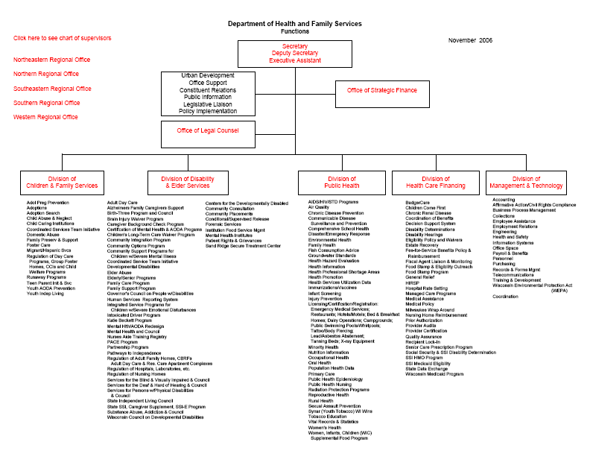
State Health Department
Organizational Chart

Slide 12
All public health activities are supported by customized information systems (databases, registries) developed to address the programmatic needs.

Slide 13
Number of Information Systems in Public Health
On average, there are
23 programs in the Local Health Departments (HDs)
19 programs in the State Health Departments
There are 3000 local HDs and 50 State HDs in the US
23 x 3000 (Local HD) = 69000 local programs/systems
19 x 50 (State HD) = 950 state programs/systems
So roughly, there are over 70 thousands public health information systems -- all of them are customized, siloed systems.

Slide 14
Integrating Public Health Information & Surveillance System
  The Centers for Disease Control and Prevention (CDC) recognizes that sound public health information is the essential ingredient of all of its work and the key to effective public health decision making.
  CDC needed to streamline and consolidate its public health surveillance and information systems into an integrated system. With integrated systems, a wide range of diverse individual information systems will continue to exist but these systems must be coordinated, interconnected, comparable, and easy to use.
  PMID: Morris G, Snider D, Katz M. CDC 10186689 [PubMed - indexed for MEDLINE]

Slide 15
1950-ties: MEDINFO
1992-2002: National Electronic Disease Surveillance System (NEDSS)
2003-2006: Public Health Information Network (PHIN)
2003-2006: Environ. Public Health Tracking Network
2005-now: CDC Biosense System
Towards Public Health Systems Integration

Slide 16
CDC National Electronic Disease Surveillance System (NEDSS)
“The vision of NEDSS is to have integrated surveillance systems that can transfer appropriate public health, laboratory, and clinical data efficiently and securely over the Internet.”
URL:http://www.cdc.gov/nedss

Slide 17
CDC Environmental Public Health Tracking Network
“To build a standards-based, coordinated, and integrated environmental public health tracking (surveillance) network at the state and national level that will allow linkage and reporting of health effects data with human exposure data and environmental hazard data.”
Source: Sandy Thames, PHIN Conference, Atlanta, GA, 2003, 2004, 2005.

Slide 18
States Efforts
Vision for Utah Child Health Advanced Records
Management System (CHARM)
PHASE I
PHASE II
Charm
Agents
Web Access
Charm
Agents
Birth
Registration
Date Ware House
Children With
Special Health
Care Needs
Newborn
Metabolic
Screening
Birth
Defects
CHARM
SERVER
Security Manager
Data Catalog
Child Registration
Matcher & Merger
Query Monitor
Statistics Manager
Newborn
Hearing
Screening
Lead
Screening
Early
Intervention
Women
Infants
Children
Utah Statewide Immunization Info System
Neonatal
Follow-up
PHASE III
Medicaid
CNEC
EPSOT System
Child Health Insurance Program
DHS-DCPS
Foster Care
Ellen Wild, etal. 2004. Key Elements for Successful Integrated Health Information Systems. JPHMP,.S36-47

Slide 19
Missouri Health Strategic Architectures and Information Cooperative Project (MOHSAIC)
Statewide Network
or Web Access
Real-time Link
BIRTHS:
Birth Loads, Name, DOB, Sex, Race, DCN
Data Merge
Other Birth Info
HEALTH MANAGEMENT
& REGULATED
Medicaid Encounters
SURVEILLANCE
INTEGRATED
Registration, Demographics, Scheduling, Inventory
Immunization TB
Family Planning
Service Coordination
EPSOT/DCY Traumatic Brain Injury Eligibility
TL-Link
Lead
Family Care Safety Registry
Bureau of Narcotics & Dangerous Drugs
Lead Inspection & Abatement
Child Care Licensing
Accredited Training Registry
INTEGRATED
DATABASE
DATABASE
DEPT. OF SOCIAL SERVICES
DCN, Medicaid Enrollment, Aging EDL, Managed Care Info, FAMIS
Communicable Disease
HIV/AIDS
STD
TB
NEOMETRICS:
Metabolic & Newborn
Hearing Results
Audiological Assessment
Private Physician Records
Private Physician Records
WIC
Highway Patrol
Laboratories
Ellen Wild, etal. 2004. Key Elements for Successful Integrated Health Information Systems. JPHMP,.S36-47

Slide 20
Despite of all efforts we do not have in the US integrated public health information system(s) neither on federal level, nor on State or Local levels.
WHY ?
Notes:


Slide 21
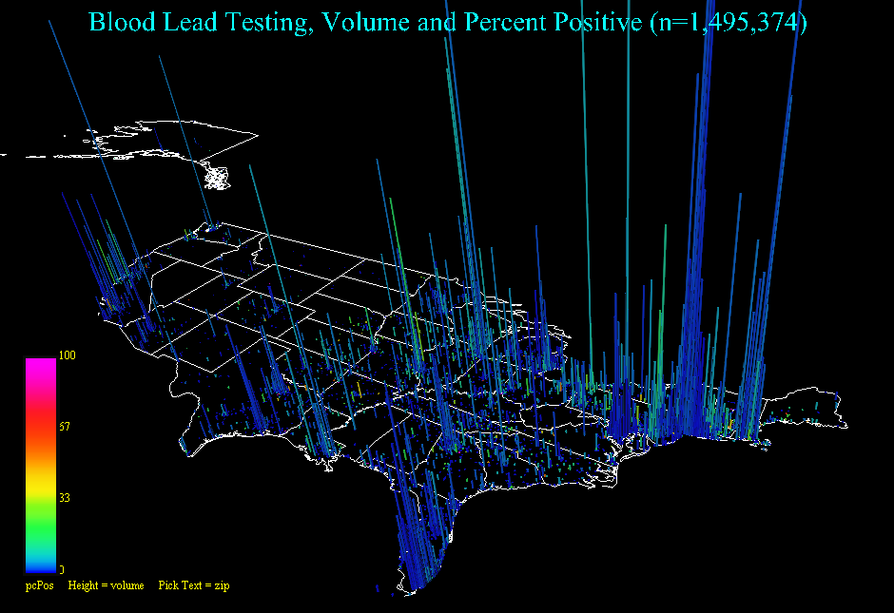
Vision for Public Health Surveillance
Percent of Children Tested for Lead with BLL>10 µg/dL in the USA
Source: Eileen Koski. Quest Diagnostics. PHIN-2004, May, Atlanta GA

Slide 22
?????????
Do we need integrated public health system(s)?
How can we build integrated public health information system(s)?
Should this integration exist within public health?
Should this integration exist within healthcare system?
Notes:


Slide 23




EHR-PH System Prototype for Interoperability in 21st Century Health Care System,
HIMSS/HL7-2005
Slide <number>
Notes:
This presentation is structured according to the following outline.
The first section will describe the product vision.
The articulation of this vision will delineate the problem addressed by the product.
The second section will describe the features of the product in the first release.
The final section describes a typical project that makes use of these features.

Slide 24
EHR-PH System Prototype for Interoperability
in 21st Century Health Care System, HIMSS-2005
Clinical Care
Public Health Surveillance
Hospital of Birth
State Health Department
ADT-
Birth Record
Newborn
Screening
Registry
HL7 2.4
HL7 3.0
Newborn Screening
Test
HL7 3.0
EHR-PH
Info Exchange
Hearing
Screening
Registry
HL7 3.0
Hearing
Screening
Test
HL7 3.0
HL7 2.4
HL7 2.4
Immunization
Registry
Immunization
Administration
HL7 3.0
HL7 2.4
Communicable
Disease
Registry
J2EE
External
Laboratory
HTB
J2EE
Wrtwertghghgghhghg
Wrtwrtghghghghgh
Wtrwtrghgg
Wrtwrtghghgh
Aadkalfjkaldkfjalkdjflajhjkhjkhjkhk
flkdjghghghghghghghgh
Wrtwertghghgghhghg
Wrtwrtghghghghgh
Wtrwtrghgg
Wrtwrtghghgh
Aadkalfjkaldkfjalkdjflajkflkdjghghghghghghghg
fhjfghjfh
Healthcare
Transaction
Viewer
HTB – Health Transaction Base
Source: Orlova, et al. HIMSS 2005,Dallas TX, February 13-17, 2005 and AMIA, Washington DC, November, 2005

Slide 25
EHR-PH System Prototype for Interoperability Clinical & Public Health Systems
Our Prototype
  illustrates how interoperability between healthcare systems can be achieved with a standards-based infrastructure
  Is built upon existing systems in clinical care and public health programs
  Enables electronic data reporting from a clinical setting to multiple public health systems
  Enables translation of customized standards into HL7 3.0 messaging standard
  Links clinical and public health systems to provide a continues view of the patient record across the systems involved
Notes:
This presentation is structured according to the following outline.
The first section will describe the product vision.
The articulation of this vision will delineate the problem addressed by the product.
The second section will describe the features of the product in the first release.
The final section describes a typical project that makes use of these features.

Slide 26
Clinical-Public Health Systems Integration:
Public Health Tasks
To understand interactions between clinical and public health data systems
To understand commonalities of data and data system architecture across clinical and public health data systems
To know computer-based tools available to public health professionals
To be able to participate in the design of information systems in public health under a NHIN

Slide 27
WHERE TO START?

Slide 28
Clinical – Public Health Data Exchanges: Local Health Agencies
Health Education/Risk Reduction
Provider 1
Communicable Diseases
Provider 2
Immunization
EPSDT
Provider 3
Injury Control
School Health
Provider 4
Chronic Care
Biosurveilance, BT, Preparedness
WIC
Provider X
Occupational Safety and Health

Slide 29
Clinical – Public Health Data Exchanges: State Health Agencies
Genetic Disorder
Vital Statistics
Communicable Diseases
Provider 1
Immunization
Provider 2
Lead and Environmental Epidemiology
Provider 3
Injury Control
School Health
Provider 4
Chronic Care
Biosurveilance, BT, Preparedness
WIC
Public Health Laboratory
Provider X
HEDIS
Cancer
Source: Beitsch et.al Structure and Function of State Public Health Care Agencies” / AJPH, January, 2006.

Slide 30
Clinical-Public Health Data Exchanges: Local / State / Federal Health Agencies
Genetic Disorder
Vital Statistics
Health Education/Risk Reduction
CDC
Communicable Diseases
Provider 1
HRSA
Communicable Diseases
Immunization
AHRQ
Lead Registry
Provider 2
Immunization
EPSDT
Injury Control
Provider 3
Injury Control
School Health
School Health
Chronic Care
Provider 4
Chronic Care
Biosurveilance, BT, Preparedness
Biosurveilance, BT, Preparedness
WIC
WIC
Public Health Laboratory
Provider X
Occupational Safety and Health
HEDIS
Cancer
Source: Beitsch et.al AJPH, January, 2006.

Slide 31
Clinical-Public Health Paper-based Health Data Exchanges
Genetic Disorders
Communicable Diseases
Provider 1
On average
49% of cases
got reported
(CDC, 2006).
Immunization
Provider 2
Vital Records
Provider 3
Injury Control
Provider 4
School Health
Chronic Care
Biosurveilance, BT, Preparedness
Provider X
HEDIS

Slide 32
Reasons for Underreporting to Public Health Agency
Lack of Knowledge of the Reporting Requirement
  Unaware of responsibility to report
  Assume that someone else (e.g., a laboratory) would report
  Unaware of which disease must be reported
  Unaware of how and whom to report
Negative Attitude Towards Reporting
  Time consuming
  Too much hassle (e.g., unwieldy report form or procedure)
  Lack of incentive
  Lack of feedback
  Distrust of government
Misconceptions that Result from Lack of Knowledge or Negative Attitude
  Compromises patient-physician relationship
  Concern that report may result in a breach of confidentiality
  Disagreement with need to report
  Judgment that the disease is not that serious
  Belief that no effective public health measures exist
  Perception that health department does not act on the report
Source: Centers for Disease Control and Prevention. Lesson Five: Public Health Surveillance. Principles of
Epidemiology in Public Health Practice. 3rd Ed. 336-409. Available at: http://www.cdc.gov/training/products/ss1000/ss1000-ol.pdf.

Slide 33
EHR-PH System Prototype for Interoperability
in 21st Century Health Care System, HIMSS-2005
Clinical Care
Public Health Surveillance
Hospital of Birth
State Health Department
ADT-
Birth Record
Newborn
Screening
Registry
HL7 2.4
HL7 3.0
Newborn Screening
Test
HL7 3.0
EHR-PH
Info Exchange
Hearing
Screening
Registry
HL7 3.0
Hearing
Screening
Test
HL7 3.0
HL7 2.4
HL7 2.4
Immunization
Registry
Immunization
Administration
HL7 3.0
HL7 2.4
Communicable
Disease
Registry
J2EE
External
Laboratory
HTB
J2EE
Wrtwertghghgghhghg
Wrtwrtghghghghgh
Wtrwtrghgg
Wrtwrtghghgh
Aadkalfjkaldkfjalkdjflajhjkhjkhjkhk
flkdjghghghghghghghgh
Wrtwertghghgghhghg
Wrtwrtghghghghgh
Wtrwtrghgg
Wrtwrtghghgh
Aadkalfjkaldkfjalkdjflajkflkdjghghghghghghghg
fhjfghjfh
Healthcare
Transaction
Viewer
HTB – Health Transaction Base
Source: Orlova, et al. HIMSS 2005,Dallas TX, February 13-17, 2005 and AMIA, Washington DC, November, 2005

Slide 34
Functional Requirements Specifications for Electronic Data Exchange between Clinical Care and Public Health:
NYC School Health & Syndromic Surveillance
2006 HRSA Contract to PHDSC

Slide 35
System Development Process
USER ROLE

Slide 36
System Development Process
System development activities
Requirements Elicitation
Design
  Analysis
  System design
  Object design
Pilot testing
Implementation
Evaluation

Slide 37
Requirements Elicitation
Requirements Elicitation includes the following activities:
Specifying problem/domain where system is needed
Identifying goals for the system
Identifying actors
Identifying functional requirements
Identifying use cases
Modeling user workflow and dataflow
Identify high level of system architecture
Identifying non-functional requirements
Stating project timeline and deliverables

Slide 38
Community Health Center (CHC) &
Automated Student Health Record (ASHR) System Data Exchange
Conduct pre-school physical examination at CHC
Input exam data into CHC Electronic Health Record System (EHRS) that populates the 211S Form
Primary Care Provider (PCP) &
Community Health Center (CHC)
Verify 211S Form
Billy
(Patient, Consumer, Student)
Print 211S Form
Update Personal Health Record (PHR) - My Chart
Export 211S Form into ASHR
Receive 211S Form from CHC EHRS
Send 211S Form to a School
Automated School Health Record
(ASHR)
Receive 211S Form from ASHR
Review student data
Billy’s Parent/Guardian
File student data into a
School Records System
Communicate to a Guardian and PCP via ASHR and CHC EHRS regarding student health concern
Italic font &
represent future functions of electronic data exchange
School Nurse &
School Record System
Fig 1. UML Use Case Diagram – Scenario 1: Healthy Child

Slide 39
Community Health Center (CHC) &
Automated Student Health Record (ASHR) System Data Exchange
Conduct pre-school physical examination at CHC
Input exam data into CHC Electronic Health Record System (EHRS) that populates the 211S Form
Verify 211S Form
Verify the Request for Educational Services (RES) Form
Primary Care Provider (PCP) &
Community Health Center (CHC)
Amy
(Patient, Consumer, Student)
Verify the Multi-Use Medication (MUM) Form
Sign Consent Form
Print 211S, RES and MUM Forms
Update Personal Health Record (PHR) - My Chart
Export 211S, RES and MUM Forms and Consent to ASHR
Receive 211S, RES and MUM Forms and Consent from CHC EHRS
Send 211S, RES and MUM Forms and Consent to a School
Automated School Health Record
(ASHR)
Receive 211S, RES and MUM Forms and Consent from ASHR
Amy’s
Parent/Guardian
Review student data
Store 211S, RES and MUM Forms and Consent in Special Needs Database
Administer medication to student
Update student’s record on the use of medication in Special Needs Database
School Nurse &
School Record System &
Special Needs Database
Italic font &
represent future functions of electronic data exchange
Submit student record to CHC EHRS via ASHR
Communicate to a Guardian and PCP via ASHR and CHC EHRS regarding student health

Slide 40
School Health: Current Work Flow and Data Flow Model:
Scenario 1- Healthy Child
Child with
parent visits
provider
Provider
completes
211S
Parent
deliver 211S
to school
School nurse
enter 211S data
into ASHR
DOHMH
maintains
ASHR
Reports
Patient
Record
211S
Form
211S
Form
211S
Form
211S
Form
ASHR
School DB
EHR
CHC EHRS
Reports

Slide 41
School Health: Current Work Flow and Data Flow Model:
Scenario 2- Child Has Asthma
Consent
Form
Consent
Form
Parent
completes
Consent
Form
Child with
parent visits
provider
Parent
deliver
Forms
to school
School nurse
enter Forms
data
into ASHR
DOHMH
maintains
ASHR
Reports
Provider
completes
211S Form
School
Forms
School
Forms
211S
Form
211S
Form
ASHR
School DB
Patient
Record
RES
Form
RES
Form
MUM
Form
MUM
Form
Reports
EHR
CHC EHRS

Slide 42
Community Health Centers
(CHC)
New York City
Schools
New York City
Department of Health &
Mental Hygiene
EHR
School
Forms
CHC-I
EHRS
School-I
System
School
Forms
EHR
211S
Form
Consent
Form
School
Forms
CHC-II
EHRS
RES
Form
MUM
Form
School-II
System
Automated
Student Health
Record
(ASHR)
System
EHR
School
Forms
CHC-N
EHRS
School-N
System

Slide 43
Functional Requirements Specifications for Electronic Data Exchange between
Clinical Care and Public Health
WORKING WITH IHE

Slide 44
School Health: Current Work Flow and Data Flow Model:
Scenario 2- Child Has Asthma
Consent
Form
Consent
Form
Parent
completes
Consent
Form
Child with
parent visits
provider
Parent
deliver
Forms
to school
School nurse
enter Forms
data
into ASHR
DOHMH
maintains
ASHR
Reports
Provider
completes
211S Form
School
Forms
School
Forms
211S
Form
211S
Form
ASHR
School DB
Patient
Record
RES
Form
RES
Form
MUM
Form
MUM
Form
Reports
EHR
CHC EHRS

Slide 45
Biosurveillance
Patient-Level Data to Public Health
Document-based Submission
HITSP
AHIC-ONC BIO Consolidated Use Case
Biosurveillance – Patient-level and Resource Utilization Interoperability Specification
Transaction Package
Consumer/Patient Id X-ref
Transaction Package
Manage Sharing of Docs
Document-based
Scenario
Transaction
Notif of Doc Availability
Transaction
Pseudonymize
Base
Std
HL7
QBP^Q23
RSP^K23
IHE
XDS-I
IHE
XDS
IHE
PIX
PDQ
IHE
NAV
Component
Lab Report Document
Component
Anonymize
IHE
XDS-MS
IHE
XDS-LAB
Component
Lab Terminology
Terminology
Standards
Base
Std
HL7
CDA r2
Base
Std
ISO
DTS/
25237
Base
Std
ISO 15000
ebRS 2.1/3.0
Base
Std
HL7 V2.5
Base
Std
DICOM
Base
Std
LOINC
HCPCS
HL7 V3
CPT
HL7 V2.5
CCC
SNOMED-CT
HIPAA
SNOMED-CT
ICD 9/10
LOINC
DICOM
NCCLS
UCUM
UB-92
URL
FIPS 5-2
HAVE

Slide 46
Towards EHR-PH Data Exchange: Clinical Care & Public Health
Genetic Disorders
Communicable Diseases
Provider 1
Immunization
Provider 2
Vital Records
Provider 3
Injury Control
Provider 4
School Health
Chronic Care
Biosurveillance, BT, Preparedness, Syndromic Surveillance
Provider X
HEDIS

Slide 47
Towards EHR-PH Data Exchange: Clinical Care & Public Health
EHR
EHR
Genetic Disorders
CDA
(Clinical
Data
Architecture)
Communicable Diseases
Provider 1
Immunization
Provider 2
IHE
(Integrated
Healthcare
Enterprise)
LAB
Vital Records
Provider 3
Injury Control
Provider 4
School Health
Chronic Care
Biosurveilance, BT, Preparedness, Syndromic Surveillance
Provider X
HEDIS

Slide 48
EHR-PH Data Exchange: Clinical & Public Health Systems
EHR
Genetic Disorders
Communicable Diseases
Provider 1
CDA2
Immunization
Provider 2
X12
Vital Records
Provider 3
Injury Control
Provider 4
School Health
NCPDP
Chronic Care
Biosurveilance, BT, Preparedness, Syndromic Surveillance
Provider X
IHE
LAB
HEDIS

Slide 49
EHR-PH Data Exchange: Clinical & Public Health Systems
EHR
Forms
Genetic Disorders
CDA2
Communicable Diseases
Provider 1
IHE
LAB
Provider 2
Immunization
Vital Records
Provider 3
NCPDP
Injury Control
Provider 4
School Health
SH
Chronic Care
X12
Biosurveilance, BT, Preparedness, Syndromic Surveillance
Provider X
BT
HEDIS

Slide 50
EHR-PH Data Exchange: Clinical & Public Health Systems
EHR
Forms
NBS
Genetic Disorders
CDA2
TB, STD.
……
Communicable Diseases
Provider 1
IHE
LAB
Provider 2
IR
Immunization
VR
Vital Records
Provider 3
NCPDP
ECIC
Injury Control
Provider 4
School Health
SH
CVD, Asthma Diabetes
Chronic Care
X12
Biosurveilance, BT, Preparedness, Syndromic Surveillance
Provider X
BT
HEDIS
HEDIS

Slide 51
WHERE TO START?
FORMS

Slide 52
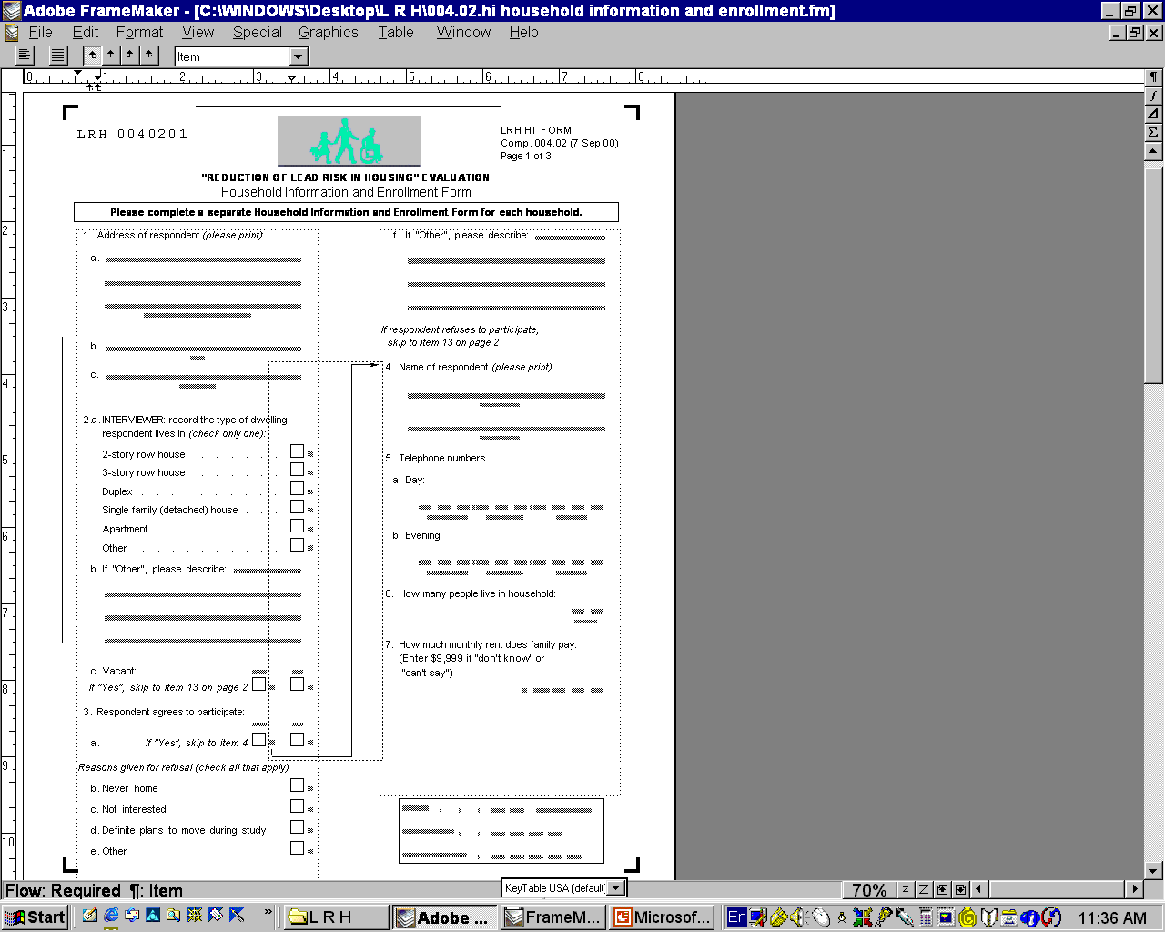
FORMS

Slide 53
EHR-PH Data Exchange: Clinical & Public Health Systems
EHR
Forms
NBS
Genetic Disorders
CDA2
TB, STD.
……
Communicable Diseases
Provider 1
IHE
LAB
Provider 2
IR
Immunization
VR
Vital Records
Provider 3
NCPDP
ECIC
Injury Control
Provider 4
School Health
SH
CVD, Asthma Diabetes
Chronic Care
X12
Biosurveilance, BT, Preparedness, Syndromic Surveillance
Provider X
BT
HEDIS
HEDIS

Slide 54
WHERE TO START?
POLICY

Slide 55
EHR-PH Data Exchange: Clinical & Public Health Systems
EHR
Forms
NBS
Genetic Disorders
CDA2
TB, STD.
……
Communicable Diseases
Provider 1
IHE
LAB
Provider 2
IR
Immunization
VR
Vital Records
Provider 3
NCPDP
ECIC
Injury Control
Provider 4
School Health
SH
CVD, Asthma Diabetes
Chronic Care
X12
Biosurveilance, BT, Preparedness, Syndromic Surveillance
Provider X
BT
HEDIS
HEDIS

Slide 56
Examples of Notifiable/Reportable Conditions by Selected States
Notifaible/Reportable Diseases (in alphabetical order) | CDC | CA |  | FL |  | IN |  | MA |  | MD |  | MN |  | NC
 |  | MD | Lab | MD | Lab | MD | Lab | MD | Lab | MD | Lab | MD | Lab | MD | Lab
Acquired Immunodeficiency Syndrome (AIDS) |  |  | - |  | - |  |  |  |  |  | - |  |  |  | 
Alcohol Related Birth Defects | - | - | - | - | - | - | - | - | - | - | - | - |  | - | -
Amebiasis | - |  | - | - | - | - | - |  |  |  |  |  | ▪ | - | -
Anaplasmosis | - | - | - | - | - | - | - | - | - | - | - |  | ▪ | - | -
Anisakiasis | - |  | - | - | - | - | - | - | - | - | - | - | ▪ | - | -
Animal bites | - | - | - |  | - |  | - | - | - |  | - | - |  | - | -
Animal bites for which rabies prophylaxis is given, | - | - | - |  | - | - | - | - | - | - | - | - |  | - | -
Anthrax |  |  |  |  |  |  |  |  |  |  |  |  | ▪ |  | 
Arboviral neuroinvasive and neuroinvasive diseases, all |  | - | - |  |  |  |  | - | - |  |  |  | ▪ |  | 
California group | - | - | - | - | - | - | - | - | - | - | - | - | ▪ | - | -
Eastern equine encephalitis virus | - | - | - | - | - | - | - |  |  | - | - | - |  | - | -

Slide 57
WHERE TO START?
WORKFLOW & DATAFLOW

Slide 58











Event Detection
Neighboring
Jurisdictions
EHRS
Hospital
State Public Health
Surveillance System
1- Report/retrieve symptoms, diagnosis & medication prescription data from EMRs
7 – Report on the positive case electronically & by phone
2 – Data mining of EMR notes
Ambulatory Care
4 – Order
pathogen test
3 – Notify on increased number of cases & recommend to order pathogen test
Local
Public Health
Surveillance System
DHHS
5 – Report
test results
P
U
B
L
I
C
6 – Report
positive
test result electronically & by phone
Media
Laboratory
Response Team
Pharmacy

Slide 59
Event Monitoring
Neighboring
Jurisdictions
Hospital
EHRS
State Public Health
Surveillance System
3 - Monitor ER visits & hospitalizations data from EMRs
1 – Send
health alert
2 - Monitor newly diagnosed cases & vaccination data from EMRs
9 – Send updates on the event
Ambulatory Care
4 – Order
pathogen test
6 – Send order to activate emergency
vaccination
5 – Report
test results
Local
Public Health
Surveillance System
10 – Send
health alert
to the public
DHHS
P
U
B
L
I
C
7 – Order/ Supply
vaccine
8 – Monitor
vaccine
supplies
Media
Lab
Response Team
Pharmacy

Slide 60
Event Management
Neighboring
Jurisdictions
EHRS
Hospital
State Public Health
Surveillance System
3 - Monitor ER visits, hospitalizations data from EMRs & utilization data
1 – Send
Outbreak updates
2 - Monitor newly diagnosed cases & vaccination data from EMRs
9 – Send outbreak updates
Ambulatory Care
4 – Order
pathogen test
6 – Send Rapid Flu Test Kits
10 – Send
outbreak updates
to the public
5 – Report
test results
Local
Public Health
Surveillance System
DHHS
P
U
B
L
I
C
9 – Activate
coordinated
response
7 – Deliver
vaccine
8 – Monitor
vaccine
supplies
Media
Lab
Response Team
Pharmacy

Slide 61

Laboratory
Cardiovascular Disease (CVD) Surveillance
Payor
Hospital
EHRS
State Public Health
Surveillance System
1 – Conduct Routine Check-ups
9 - Monitor ER visits, hospitalizations data from EMRs & utilization data
4 – Prescribe Medication and Treatment Plan
11 – Send reports
Ambulatory Care
12– Conduct Surveys (BRFSS)
5 – Monitor Treatment
2 – Order
cholesterol test
7 – Report Data to Schools
3 – Report
test results
Local CVD
Surveillance System
10 – Conduct Health
Education
DHHS
P
U
B
L
I
C
6 – Fill Prescription
8– Coordinate
Care
Media
School
Pharmacy

Slide 62
Laboratory
Hospital
Asthma Surveillance
Payor
EHRS
State Public Health
Surveillance System
1 – Conduct Routine Check-ups
9 - Monitor ER visits, hospitalizations data from EMRs & utilization data
4 – Prescribe Medication and Treatment Plan
Ambulatory Care
11 – Send reports
5 – Monitor Treatment
12– Conduct Surveys (BRFSS)
2 – Order
allergen test
7 – Report Data to Schools
3 – Report
test results
Local Asthma
Surveillance System
10 – Conduct Health
Education
DHHS
P
U
B
L
I
C
6 – Fill Prescription
8– Coordinate
Care
Media
School
Pharmacy

Slide 63
WHERE TO START?
SELECT PUBLIC HEALTH DOMAINS TO BEGIN WITH

Slide 64
EHR-PH Data Exchange: Clinical & Public Health Systems
EHR
Forms
NBS
Genetic Disorders
CDA2
TB, STD.
……
Communicable Diseases
Provider 1
IHE
LAB
Provider 2
IR
Immunization
VR
Vital Records
Provider 3
NCPDP
ECIC
Injury Control
Provider 4
School Health
SH
CVD, Asthma Diabetes
Chronic Care
X12
Biosurveilance, BT, Preparedness, Syndromic Surveillance
Provider X
BT
HEDIS
HEDIS

Slide 65
WHAT ARE THE OUTCOMES?

Slide 66

US Health Care System Standardization: 2005-now
Discussion Document
Standards Harmonization Technical Committees Update
Report to the Healthcare Information Technology Standards Panel
Contract HHSP23320054103EC
HITSP includes 206 member organizations:
17 SDOs (8%)
161 Non-SDOs (79%)
18 Govt. bodies (8%)
10 Consumer groups (5%)
Arlington, VA
September 20, 2006

Slide 67
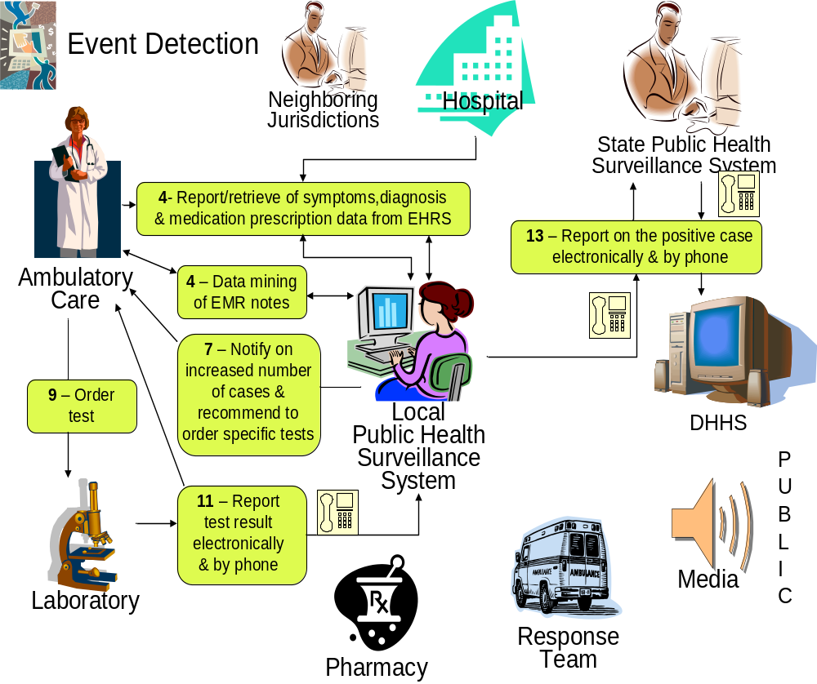
AHIC Biosurveillance Use Case

Slide 68
Biosurveillance
Patient-level data to Public Health
Message-based Submission
HITSP
AHIC-ONC BIO Consolidated Use Case
Biosurveillance – Patient-level and Resource Utilization Interoperability Specification
Transaction Package
Consumer/Patient Id X-ref
Transaction
Pseudonymize
Base
Std
HL7
QBP^Q23
RSP^K23
Message-based
Scenario
IHE
XDS
IHE
PIX
PDQ
Component
Encounter Msg
Component
Lab Report Message
Component
Anonymize
Component
Radiology Msg
Component
Lab Terminology
Terminology
Standards
Base
Std
ISO
DTS/
25237
Base
Std
HL7V2.5
ADT^xxx
Base
Std
ISO 15000
ebRS 2.1/3.0
Base
Std
HL7 V2.5
HCPCS
HL7 V3
Base
Std
HL7V2.5
ORU^R01
Base
Std
LOINC
CPT
HL7 V2.5
HIPAA
CCC
SNOMED-CT
DICOM
ICD 9/10
LOINC
SNOMED-CT
NCCLS
UCUM
UB-92
URL
FIPS 5-2
HAVE

Slide 69
Biosurveillance
Patient-Level Data to Public Health
Document-based Submission
AHIC-ONC BIO Consolidated Use Case
HITSP
Biosurveillance – Patient-level and Resource Utilization Interoperability Specification
Transaction Package
Consumer/Patient Id X-ref
Transaction Package
Manage Sharing of Docs
Document-based
Scenario
Transaction
Notif of Doc Availability
Transaction
Pseudonymize
Base
Std
HL7
QBP^Q23
RSP^K23
IHE
XDS-I
IHE
XDS
IHE
PIX
PDQ
IHE
NAV
Component
Lab Report Document
Component
Anonymize
IHE
XDS-MS
IHE
XDS-LAB
Component
Lab Terminology
Terminology
Standards
Base
Std
HL7
CDA r2
Base
Std
ISO
DTS/
25237
Base
Std
ISO 15000
ebRS 2.1/3.0
Base
Std
HL7 V2.5
Base
Std
DICOM
Base
Std
LOINC
HCPCS
HL7 V3
CPT
HL7 V2.5
CCC
SNOMED-CT
HIPAA
SNOMED-CT
ICD 9/10
LOINC
DICOM
NCCLS
UCUM
UB-92
URL
FIPS 5-2
HAVE

Slide 70
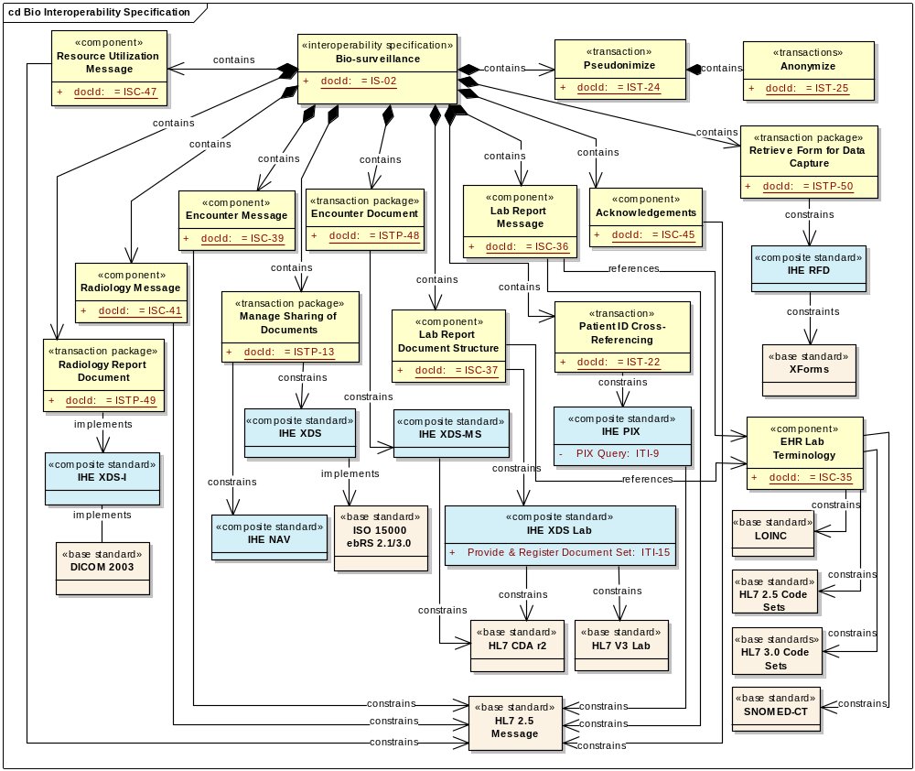
Biosurveillance Technical Committee Recommendations

Slide 71


Providers and Software Developers
Working Together to Deliver
Interoperable Health Information Systems
in the Enterprise
and Across Care Settings
PHDSC will Sponsor
Public Health Domain at IHE

Slide 72
PHDSC will Sponsor Creation of
Public Health Domain at IHE
Public Health Efforts at IHE
White Paper on Public Health Case Management Profile – due July 2007
Will be PHDSC-sponsored
Profile Proposal on Aggregate Data Retrieval from Document-Sharing Resource
Siemens- and Oracle-sponsored
Profile Proposal on Public Health Reporting
IBM-sponsored

Slide 73
Public Health Data Standards Consortium
http://www.phdsc.org
Notes:
The purpose of this presentation is to familiarize you or the organization you represent with an independent body called the Public Health Data Standards Consortium. The Consortium is a unique entity made up of federal agencies, state organizations, regional consortia, professional associations and academia that collectively represent the interests of public health and health services research in the data standards setting processes. This presentation can be used as is or customized to address your needs or those of your organization.

Slide 74
The Public Health Data Standards Consortium (Consortium) is a non-profit membership-based organization of federal, state and local health agencies; national and local professional organizations; academia; public and private sector organizations; international members; and individuals.
Our goal is to empower the agents of health and healthcare with public health information standards to improve individual and community health.
Members of this confederation recognized a need for an organized common voice from public health in the national healthcare standardization efforts. To become this voice, the Consortium became a not-for-profit organization in July 2003.

Slide 75

PHDSC’s Mission
PHDSC is committed
to bring a common voice
from the
public health community
to the national efforts of standardization of
health and
healthcare information
Enhanced
Health
and Health Care
Enhanced
Enhanced
Enhanced
Enhanced
Enhanced
Enhanced
Enhanced
Health and
Health and
Health and
Health and
Health
Health
Health
and Health Care
and Health Care
and Health Care
Health Care
Health Care
Health Care
Health Care
Improved
Health Information
Improved
Improved
Improved
Improved
Improved
Improved
Improved
Health Information
Health Information
Health Information
Health Information
Health Information
Health Information
Health Information
Health Data Standards
Health Data Standards
Health Data Standards
Health Data Standards
Health Data Standards
Health Data Standards
Health Data Standards
Health Data Standards

Slide 76
Members include …
Federal Agencies
Federal Agencies
Agency for Healthcare Research and Quality (AHRQ)
Centers for Disease Control and Prevention (CDC)
INSERM, France
CDC/National Center for Health Statistics (NCHS)
National Library of Medicine (NLM)
Substance Abuse and Mental Health Services Administration/Center for Mental Health Services (SAMHSA)
State and Local Agencies
State Agencies
& Regional Consortia
California Office of Stateside Health Planning & Development
Massachusetts Division of Health Care Finance and Policy
Nebraska Health and Human Services System
Ohio State Department of Health
Wisconsin Department of Health & Family Services
Minnesota Department of Health
New York City Department of health & Mental Hygiene
Academia Institutions & Other
Other Professional Organizations
Johns Hopkins University
Massachusetts Health Data Consortium
Institute for HIPAA/HIT Education
Illinois Hospital Association
Delta Dental Plans Association
Public Health Informatics Institute
Notes:
The Consortium is a coalition of several organizations committed to the promotion of data standards for public health and health services research

Slide 77
Members include …
For-Profit Members
Federal Agencies
Professional Membership
Organization
State Agencies
ESRI
Fox Systems
HLN Consulting
GlaxoSmithKline
Oz Systems
Oracle Corporation
STC
& Regional Consortia
American Immunization registry Association (AIRA)
Association of Public Health Laboratories (APHL)
eHealth Initiative
Council for State and Territorial Epidemiologists (CSTE)
National Association for Health data Organization (NAHDO)
National Association of City and County health Officers (NACCHO)
North American Association of Cancer Registries (NAACR)
Academic Institutions
Johns Hopkins University
Johns Hopkins Bloomberg School of Public Health
Vanderbilt University
University of Connecticut
Notes:
The Consortium is a coalition of several organizations committed to the promotion of data standards for public health and health services research

Slide 78
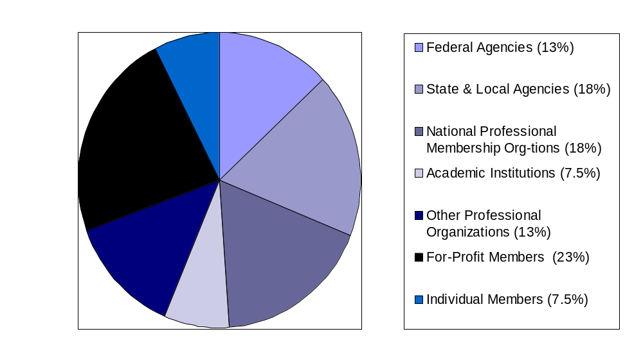
PHDSC – Membership Structure

Slide 79
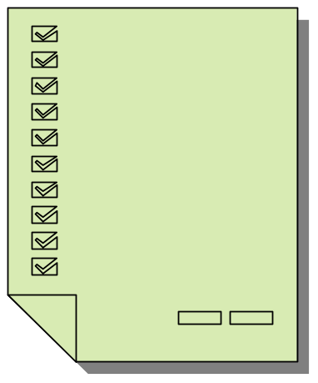


PHDSC has a proven track record: 1999-2004
05/01
PHDSC Education Strategy on Data Standards
10/02
Health Care Services
Reporting Guide
03/04
Electronic Health Record- Public Health
(EHR-PH)
White Paper
1999
PHDSC Established
as a Voluntary
Confederation
07/03
PHDSC became a non-profit organization
06/00
Mother’s Medical Record Number is added on Health Care Claim
05/03
Web-based Resource Center
03/02
Health Data Standards Survey
2000
PHDSC Members
Join Data Content Committees

Slide 80
PHDSC has a proven track record: 2005-2006
01/05
Response to the PFI on the NHIN Development and Adoption of a NHIN
6/05
Role of Public Health in Adoption and Use of HIT
02/06
Payer Typology Standards
09/05
Privacy and Security WebSites
12/06
Vision for a Functional Standard for HIsE between Clinical Care and Public Health
02/05
EHR-PH Prototype at HIMSS

Slide 81
Public Health Data Standards Consortium
December 2003 - March 2004
PHDSC conducted national validation of the HL7 EHR Functional Model.
PHDSC developed a White Paper “Electronic Health Record- Public Health (EHR-PH).”
AHIMA & HL7 stated that “the PHDSC validation was the best validation conducted to date.”
URL: http://www.phdsc.org

Slide 82
EHR-PH System Prototype for Interoperability
in 21st Century Health Care System, HIMSS-2005
Clinical Care
Public Health Surveillance
Hospital of Birth
State Health Department
ADT-
Birth Record
Newborn
Screening
Registry
HL7 2.4
HL7 3.0
Newborn Screening
Test
HL7 3.0
EHR-PH
Info Exchange
Hearing
Screening
Registry
HL7 3.0
Hearing
Screening
Test
HL7 3.0
HL7 2.4
HL7 2.4
Immunization
Registry
Immunization
Administration
HL7 3.0
HL7 2.4
Communicable
Disease
Registry
J2EE
External
Laboratory
HTB
J2EE
Wrtwertghghgghhghg
Wrtwrtghghghghgh
Wtrwtrghgg
Wrtwrtghghgh
Aadkalfjkaldkfjalkdjflajhjkhjkhjkhk
flkdjghghghghghghghgh
Wrtwertghghgghhghg
Wrtwrtghghghghgh
Wtrwtrghgg
Wrtwrtghghgh
Aadkalfjkaldkfjalkdjflajkflkdjghghghghghghghg
fhjfghjfh
Healthcare
Transaction
Viewer
HTB – Health Transaction Base
Source: Orlova, et al. HIMSS 2005,Dallas TX, February 13-17, 2005 and AMIA, Washington DC, November, 2005

Slide 83
Building a NHIN
On November 15, 2004 Office of National Coordinator for Health Information Technology (ONC), Department of Health and Human Services (DHHS), released
THE REQUEST FOR INFORMATION (RFI)
on the Development and Adoption of a “National” Health Information Network
Over 500 responses from various healthcare stakeholders has been submitted.
URL: http://www.dhhs.gov

Slide 84
Public Health Data Standards Consortium
PHDSC RESPONSE TO THE RFI
on the Development and Adoption of a “National” Health Information Network
was submitted to DHHS on January 18, 2005
URL: http://www.phdsc.org

Slide 85
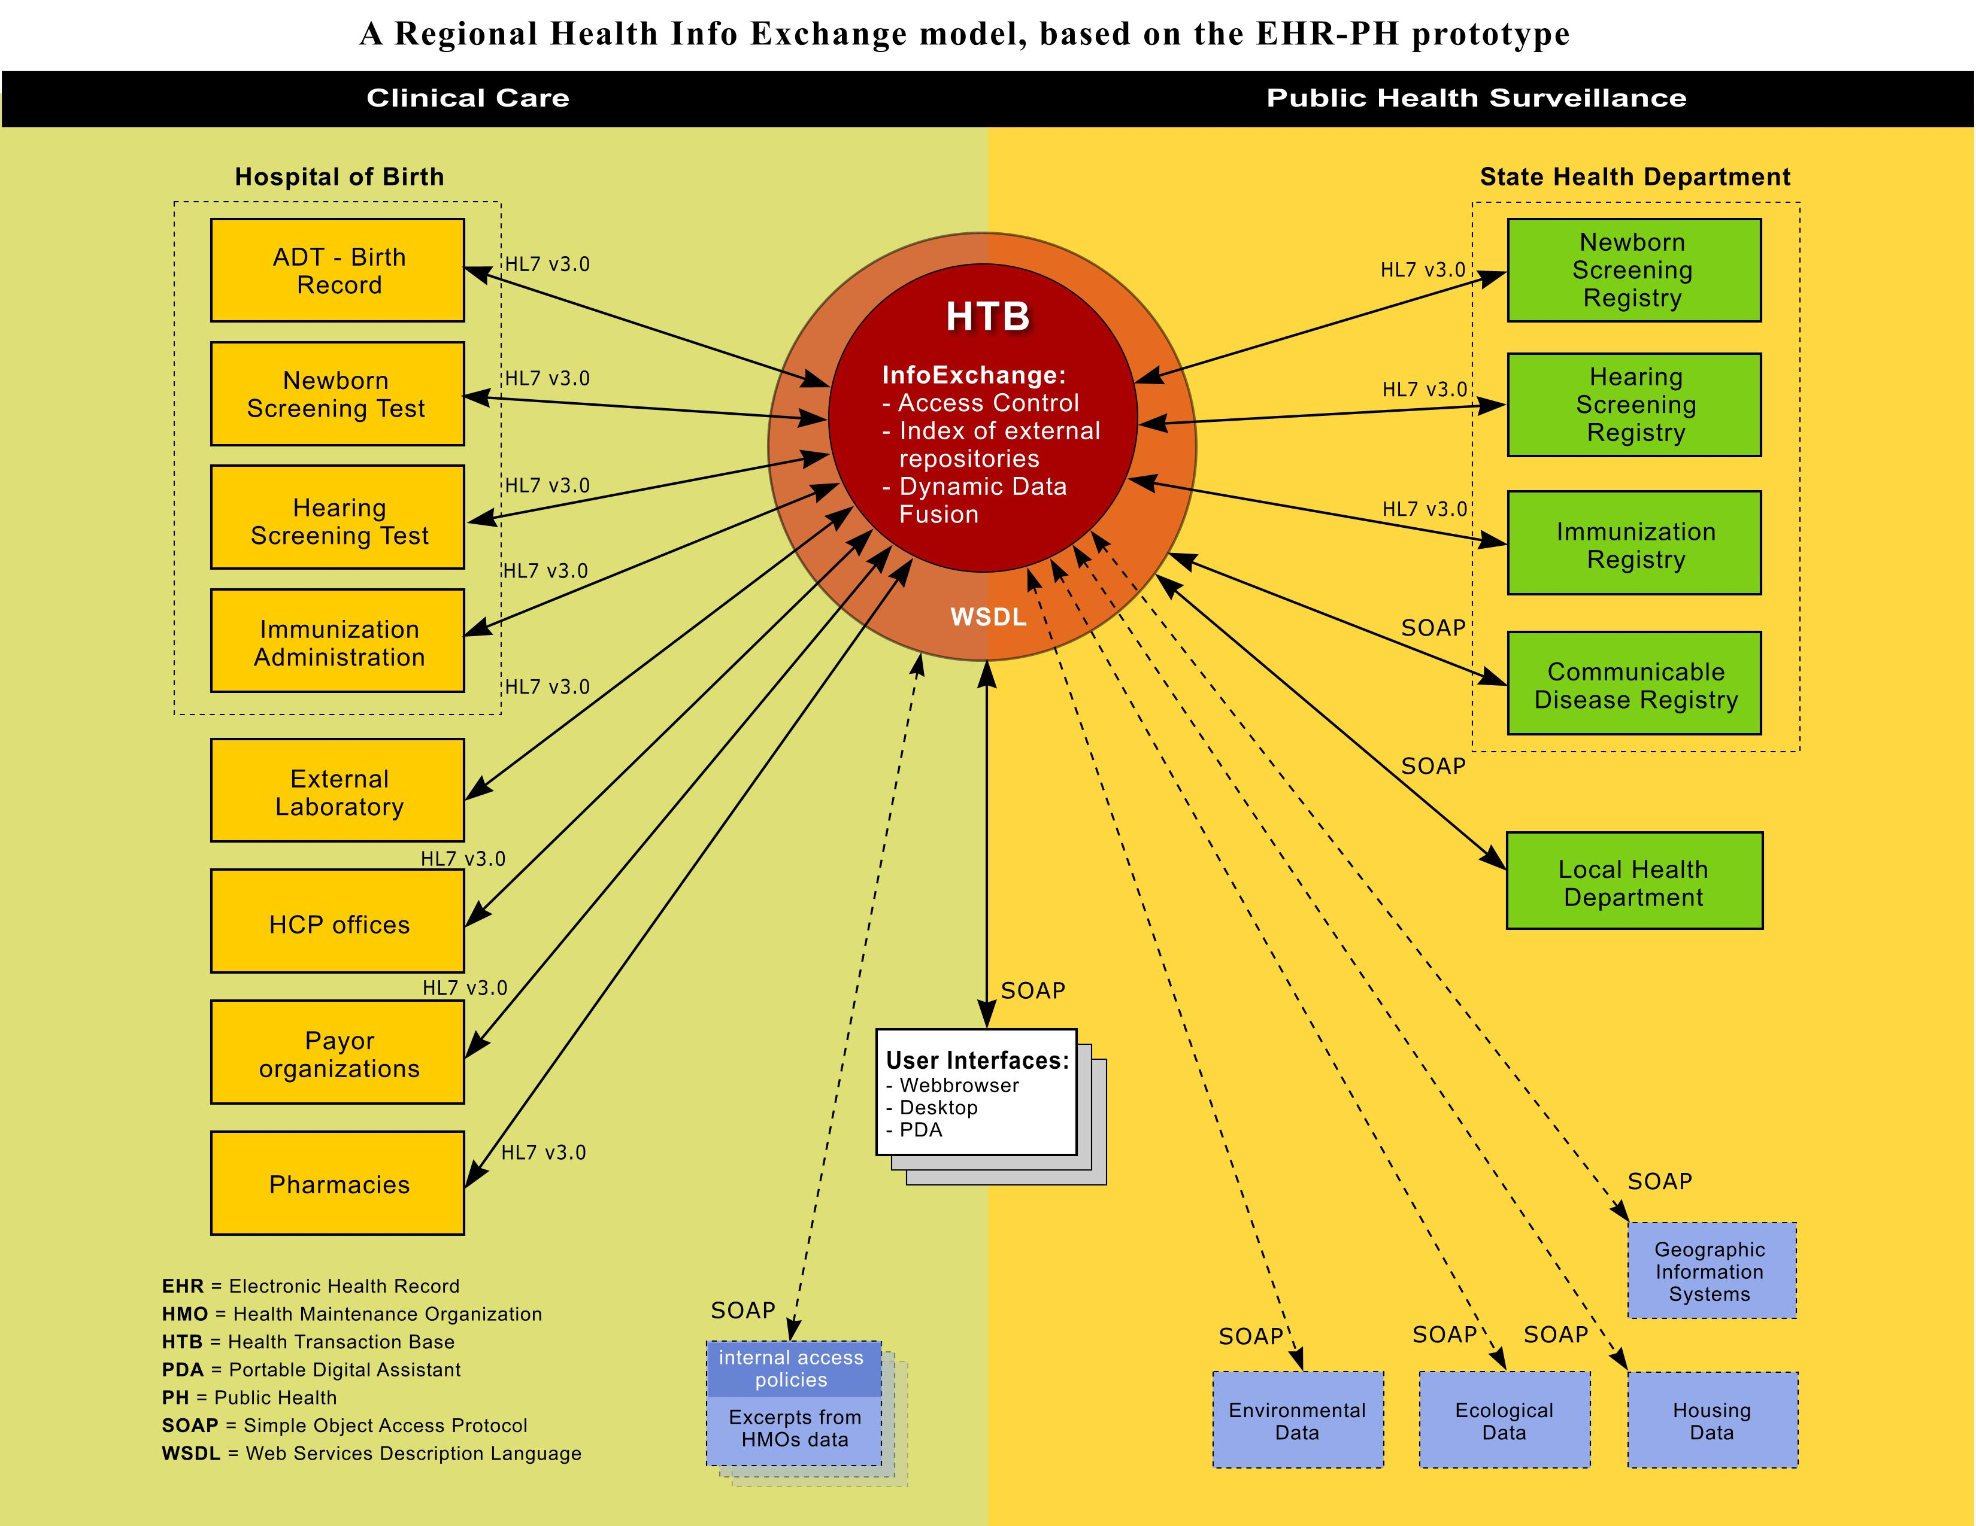
PHDSC Model:
PHDSC Model for Electronic Health Record-based Data Exchange
RHIO
EHR-PH
Info
Exchange

Slide 86
PHDSC Involvement
The Certification Commission for Healthcare Information Technology (CCHIT)
Healthcare Information Technology Standards Panel (HITSP)
American Health Information Community
(Community)
The Health Information Security and Privacy Collaboration (HISPC)
Nationwide Health Information Network (NHIN) Architecture Projects

Slide 87

Anna Orlova, PhD, Executive Director
624 N. Broadway Room 325 Baltimore MD 21205
Phone: 410-614-3463 Fax: 410-614-3097 E-mail: aorlova@jhsph.edu

